Slide 1
Efficient Data Collection

Slide 3
How can we be more efficient?
Project
Planning
Data Collection
*
Data
Entry
*
Data
Correction
*
Data Organizing for Analysis
*
Data Analysis

Slide 4
How can we be more efficient?
Project
Planning
How much data? What data?: Have clear research questions and analysis plan; Don’t waste time collecting data you don’t need
Data Collection
How do we collect it? Save time when you collect and enter data; collect it in a way that minimizes data entry errors
*
Data
Entry
*
Data
Correction
*
Data Organizing for Analysis
*
Data Analysis

Slide 5
Why does this matter?

Slide 6
$1 to check the data at first point of entry, it likely costs $10 to correct the error as part of the greater batch. If the incorrect data slips through without correction, the cost of fixing the mistake by the time it reaches customers or the production line is likely to increase ten fold
1-10-100 Rule
“the cost of quality”
Data entry errors multiply costs exponentially according to the stage at which they are identified and corrected.
$1:
Price to check the data at first point of entry
$10:
Price to find and correct error when it is part of a batch
$100:
Cost of fixing the mistake when it reaches customers
prevention is less costly than correction is less costly than failure

Slide 7
Effort now saves time, money, & stress later.

Slide 8
Where can errors be introduced?
Review
Improvement
Goals & Objectives
Results
Processes
“Process Audit”

Slide 9

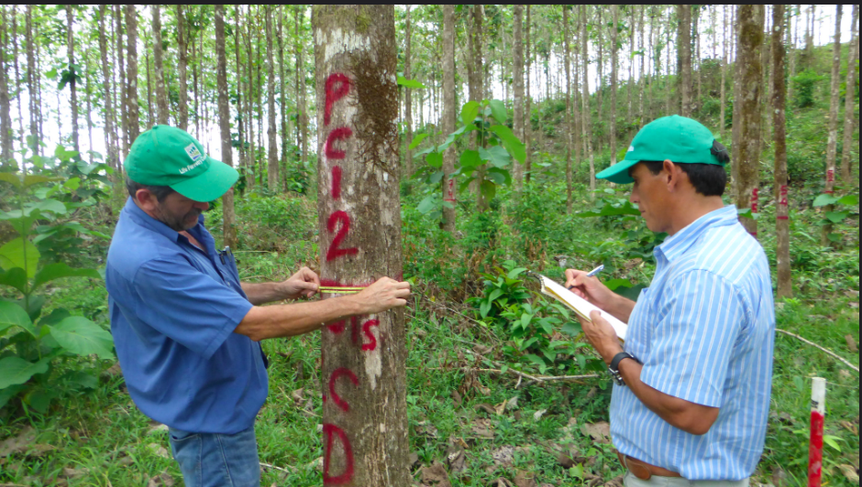

Slide 10
Scribe reads out incorrect number of tree he wants measured
Scribe reads out correct number of tree he wants measured but assistant hears wrong number
Scribe reads the number of the tag or tree incorrectly (so ‘correct’ measurement is recorded, but for a tree different from the one the scribe wanted).
Scribe incorrectly measures tree (doesn’t know how to use dbh tape, knows how to use it but makes a mistake, measures tree in the wrong place, tape is poor quality, different brand tapes at different times, measures to wrong level of precision)
Scribe writes down incorrect value
Scribe writes down illegible value
Fail to record data you need (gps points, plot, number)
8. Misidentify species
9. Write down incorrect species
10. Switch jobs and so record data inconsistently or incorrectly
11. Lose data sheet
12. Data sheet partially damaged

Slide 11
What can I do?
Automation
Asset Management
UX/UI
Notes:
Automation – esp for repeated measurments, large volums (AI), and dat backup
User Experience/User Interface

Slide 12
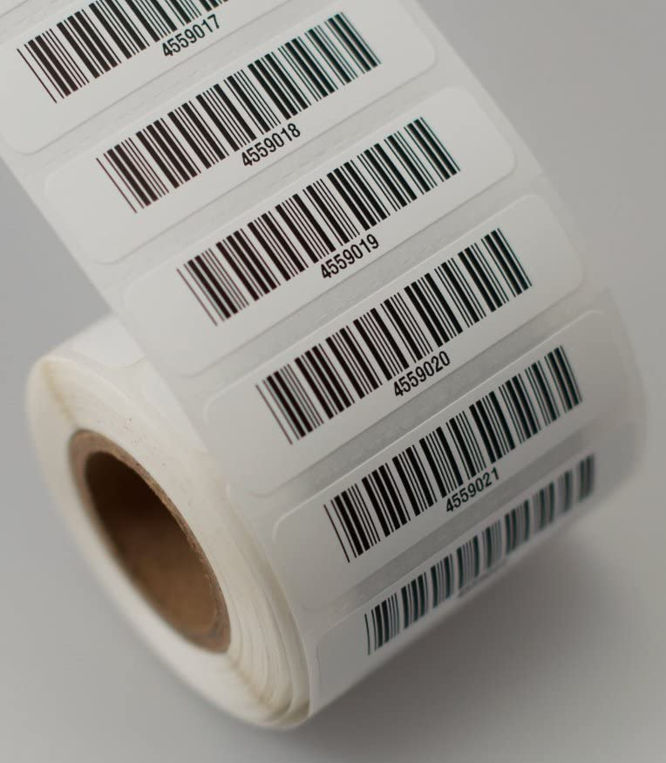
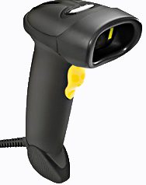

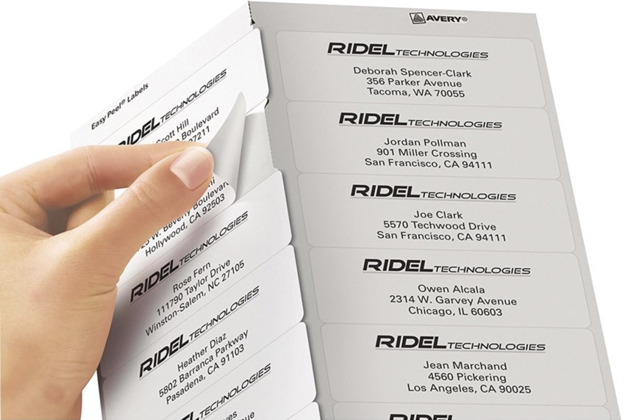
Asset Management
Save time and reduce errors by labeling items (e.g., vials, sheets, forms) and “fill out” forms in advance.

Slide 13
UX/UI
Save time and reduce errors by formatting forms to speed up data collection, minimize errors, and streamline data entry.
Bisits Bullen, Piroska. How to design survey forms for quick data entry.
Coyle, Andrew. “Form design best practices”

Slide 14
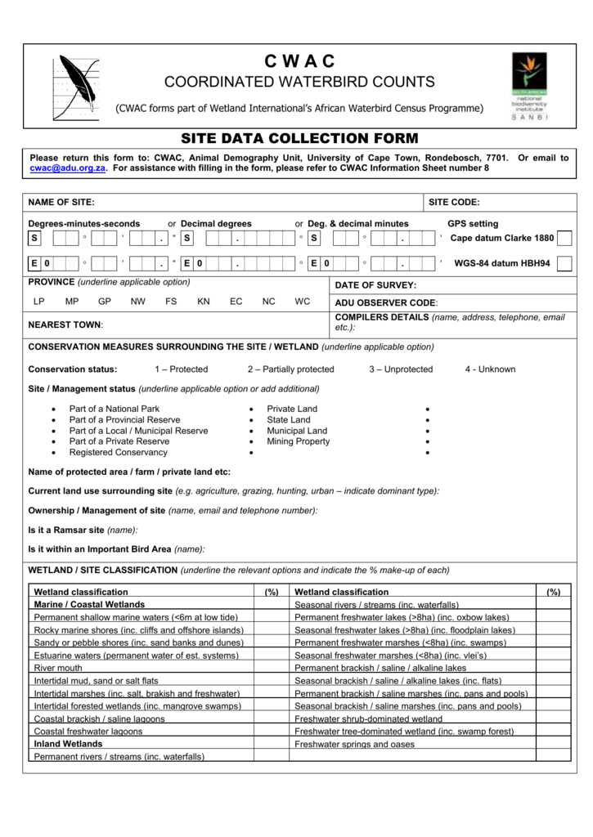
Conduct a “Process Audit” of these data collection forms
What would your UX be if you were filling out these forms?

Slide 15
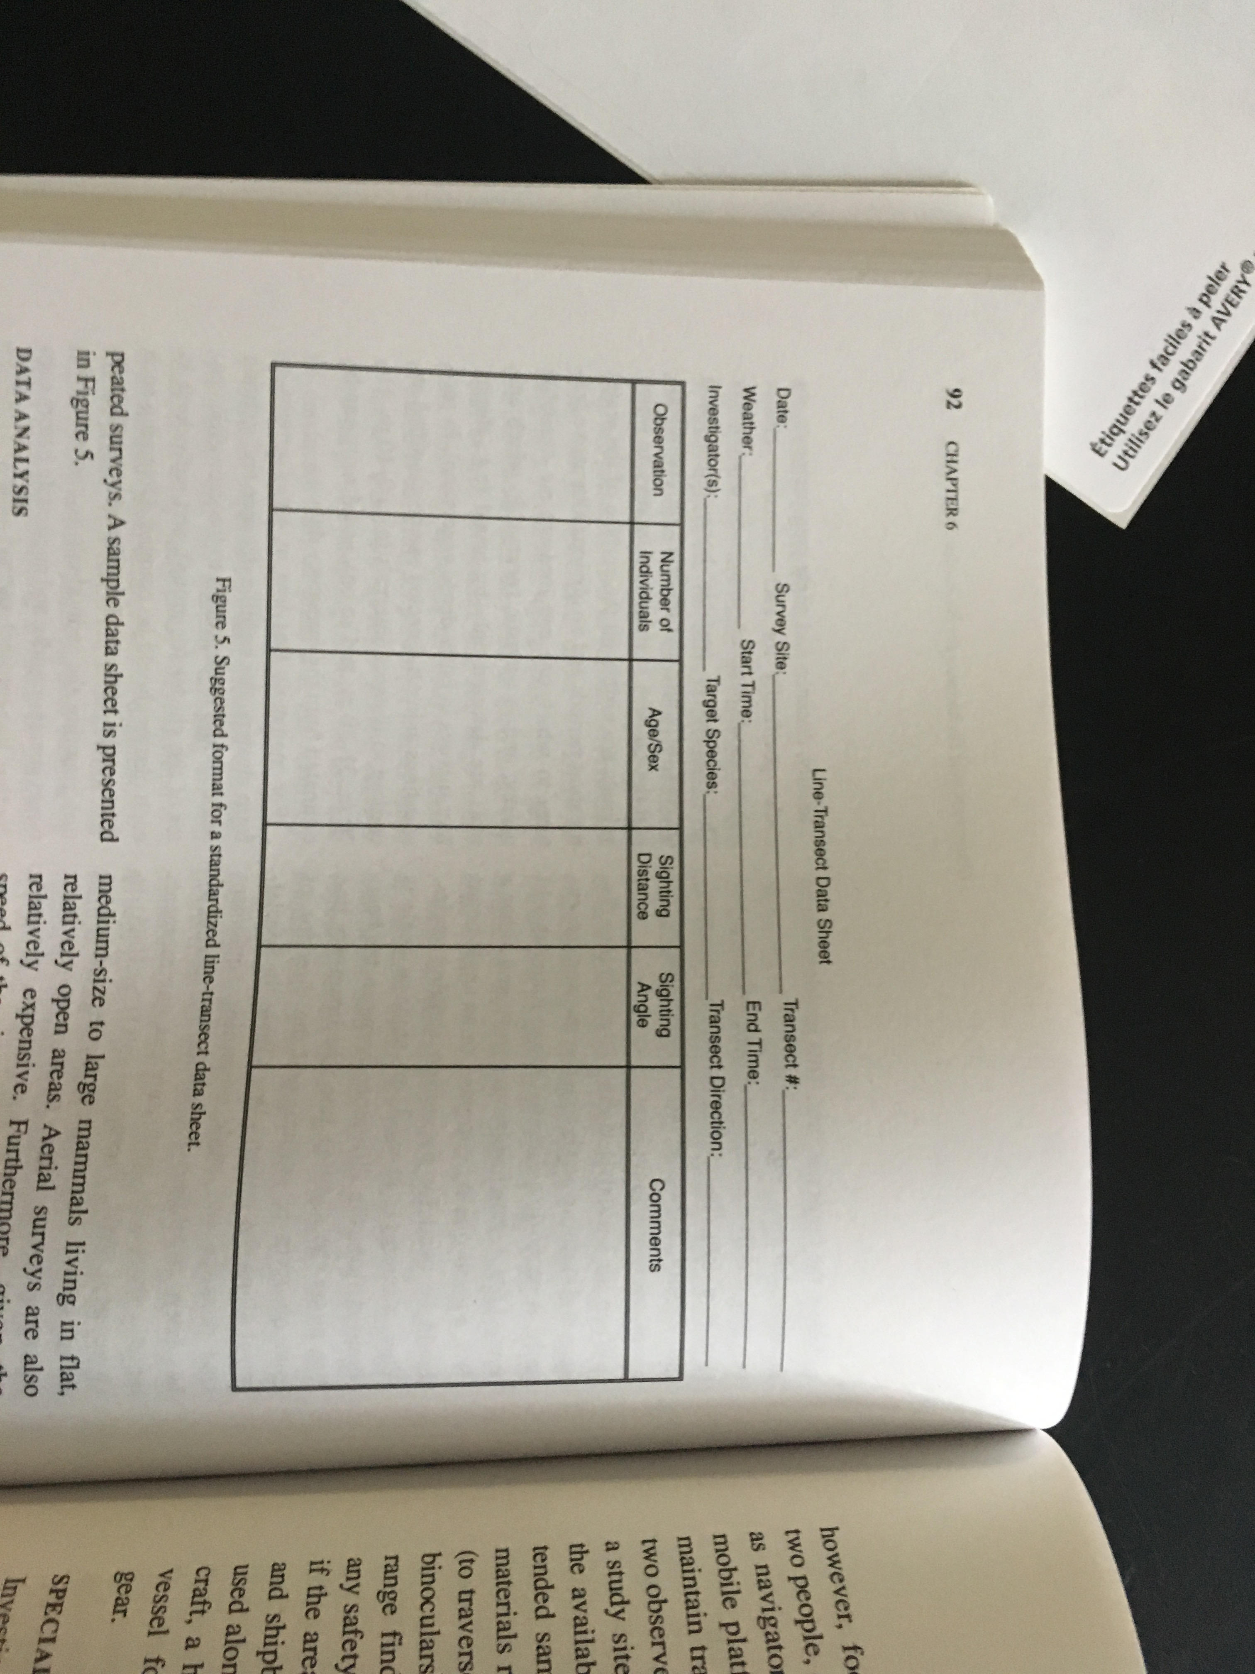


Slide 17
Reduce Cognitive Overload (aka keep it simple)
Write as little as possible

Slide 18
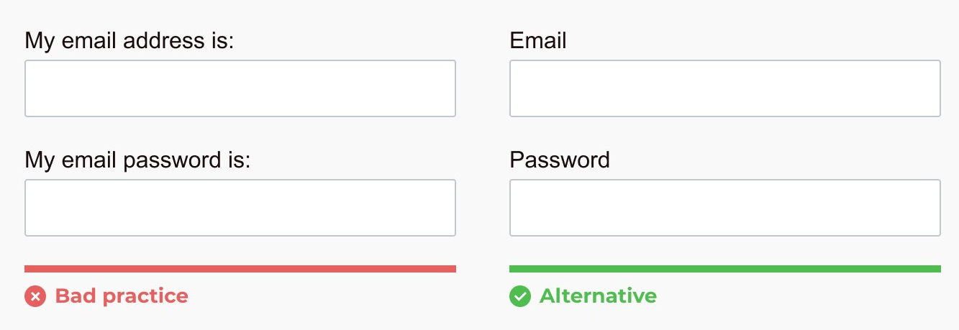
Use labels & keep them short…

Slide 19
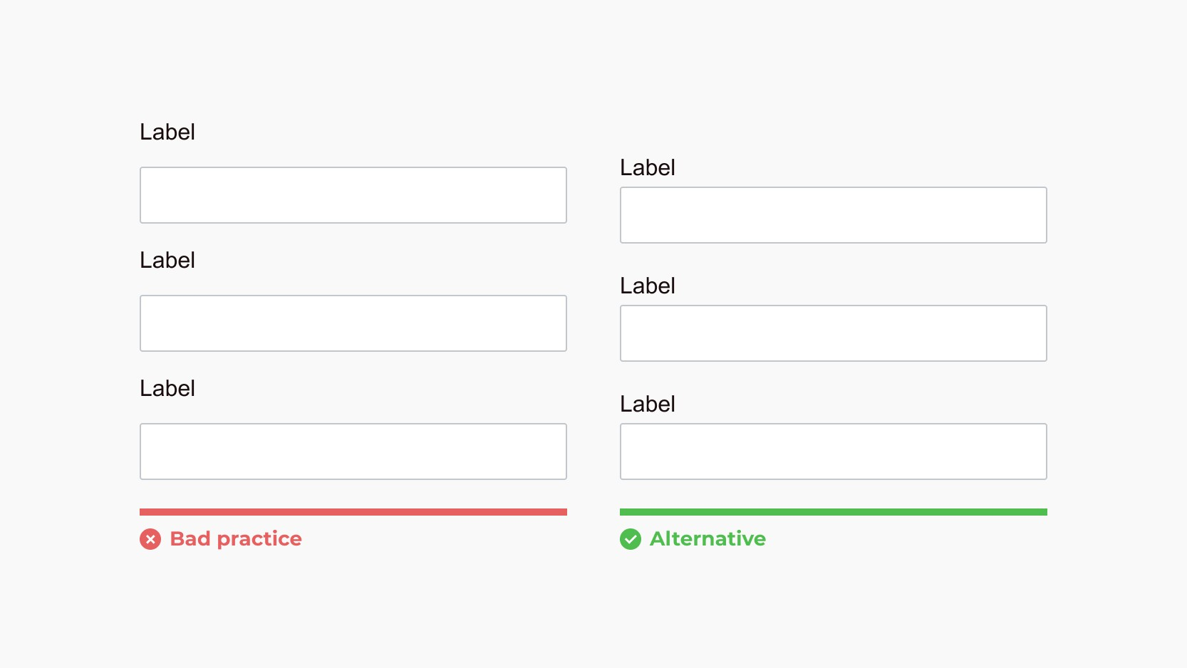
Be careful with the location of input labels to avoid mistakes
Poor alignment leads to filling out forms incorrectly

Slide 20
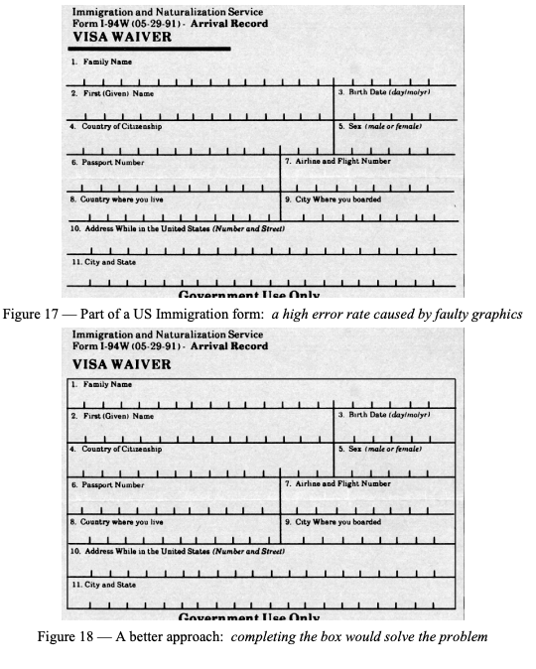
…and pay attention to where you put the labels

Slide 21
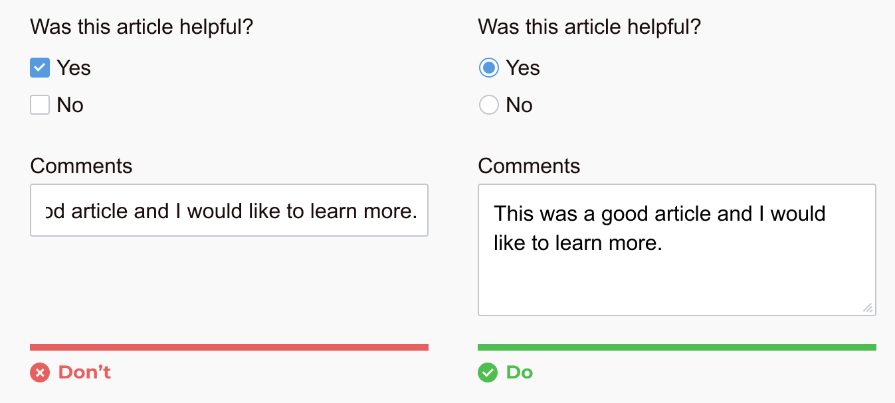
Use the appropriate input type and tag…
Radio Button vs. Check Box

Slide 22
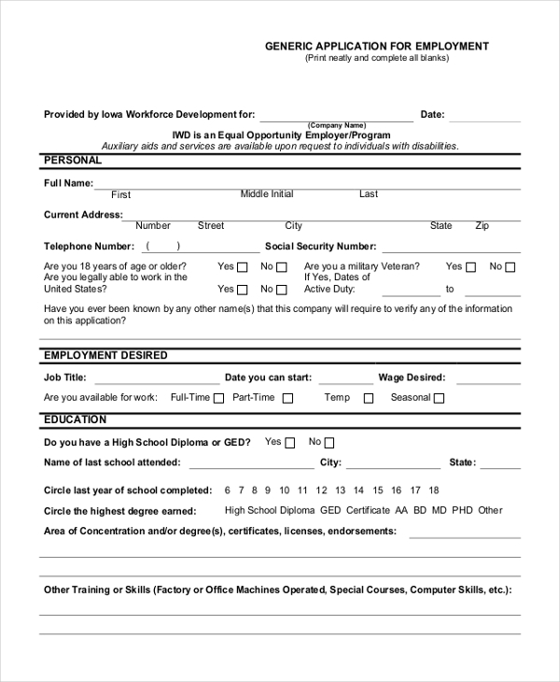
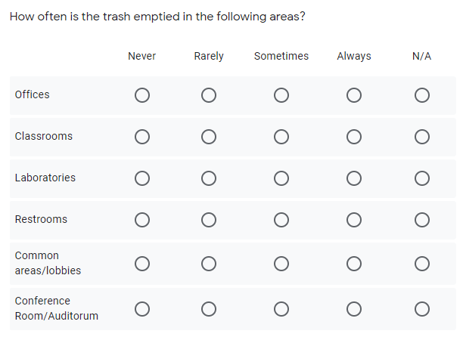
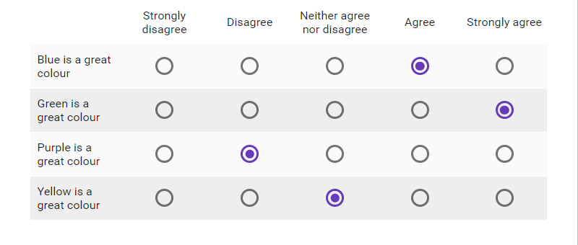
Use the appropriate input type and tag…and format them in helpful ways
Blanks vs. Fill-in Boxes (narrow, wide, height)
Circling Options vs Check Boxes (distance between)
Likert scale options (vertical vs. horizontal, direction of impact, words vs. numbers)
Options to constrain errors vs. Unknown Results
M? D? Y?

Slide 23
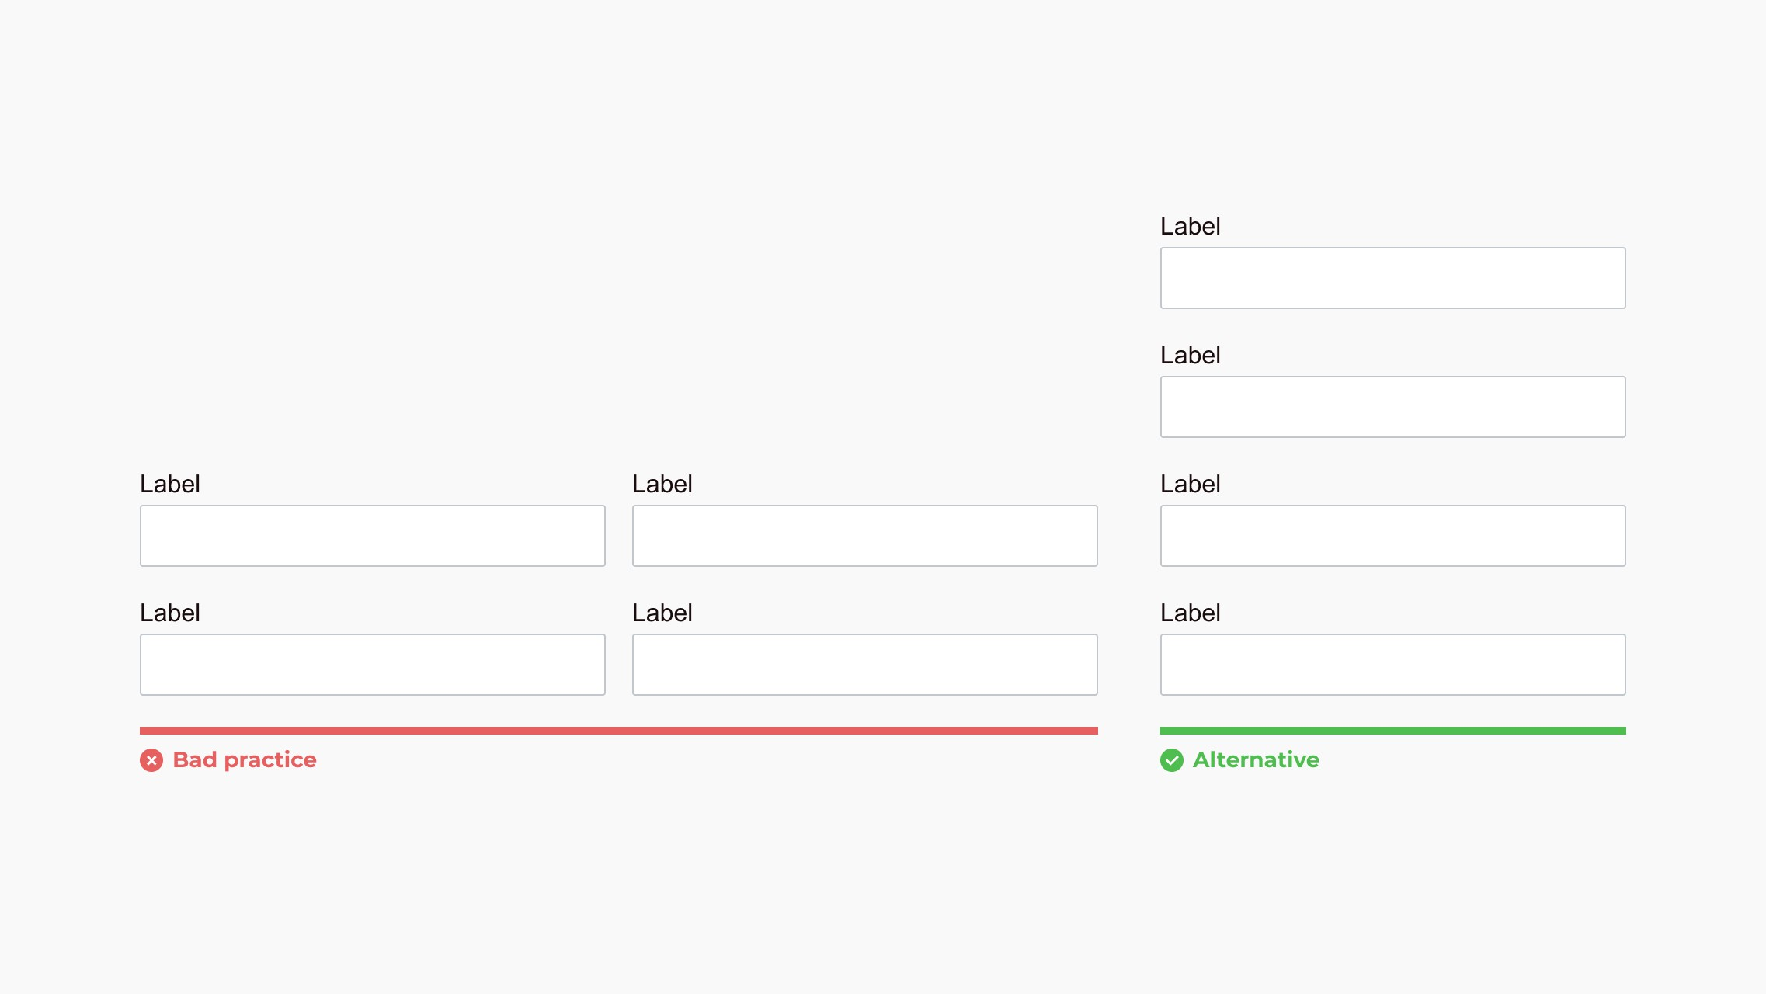
Forms should be one column…
One-column forms are more comfortable to scan and conform better to mobile displays. Multiple columns can strain a user and cause them to skip fields accidentally.

Slide 24
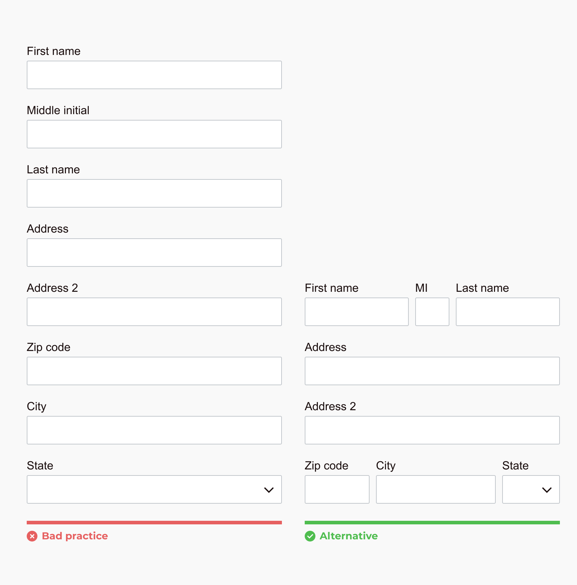
…Except when multi-column makes sense
Fields that logically go together should be inline

Slide 25
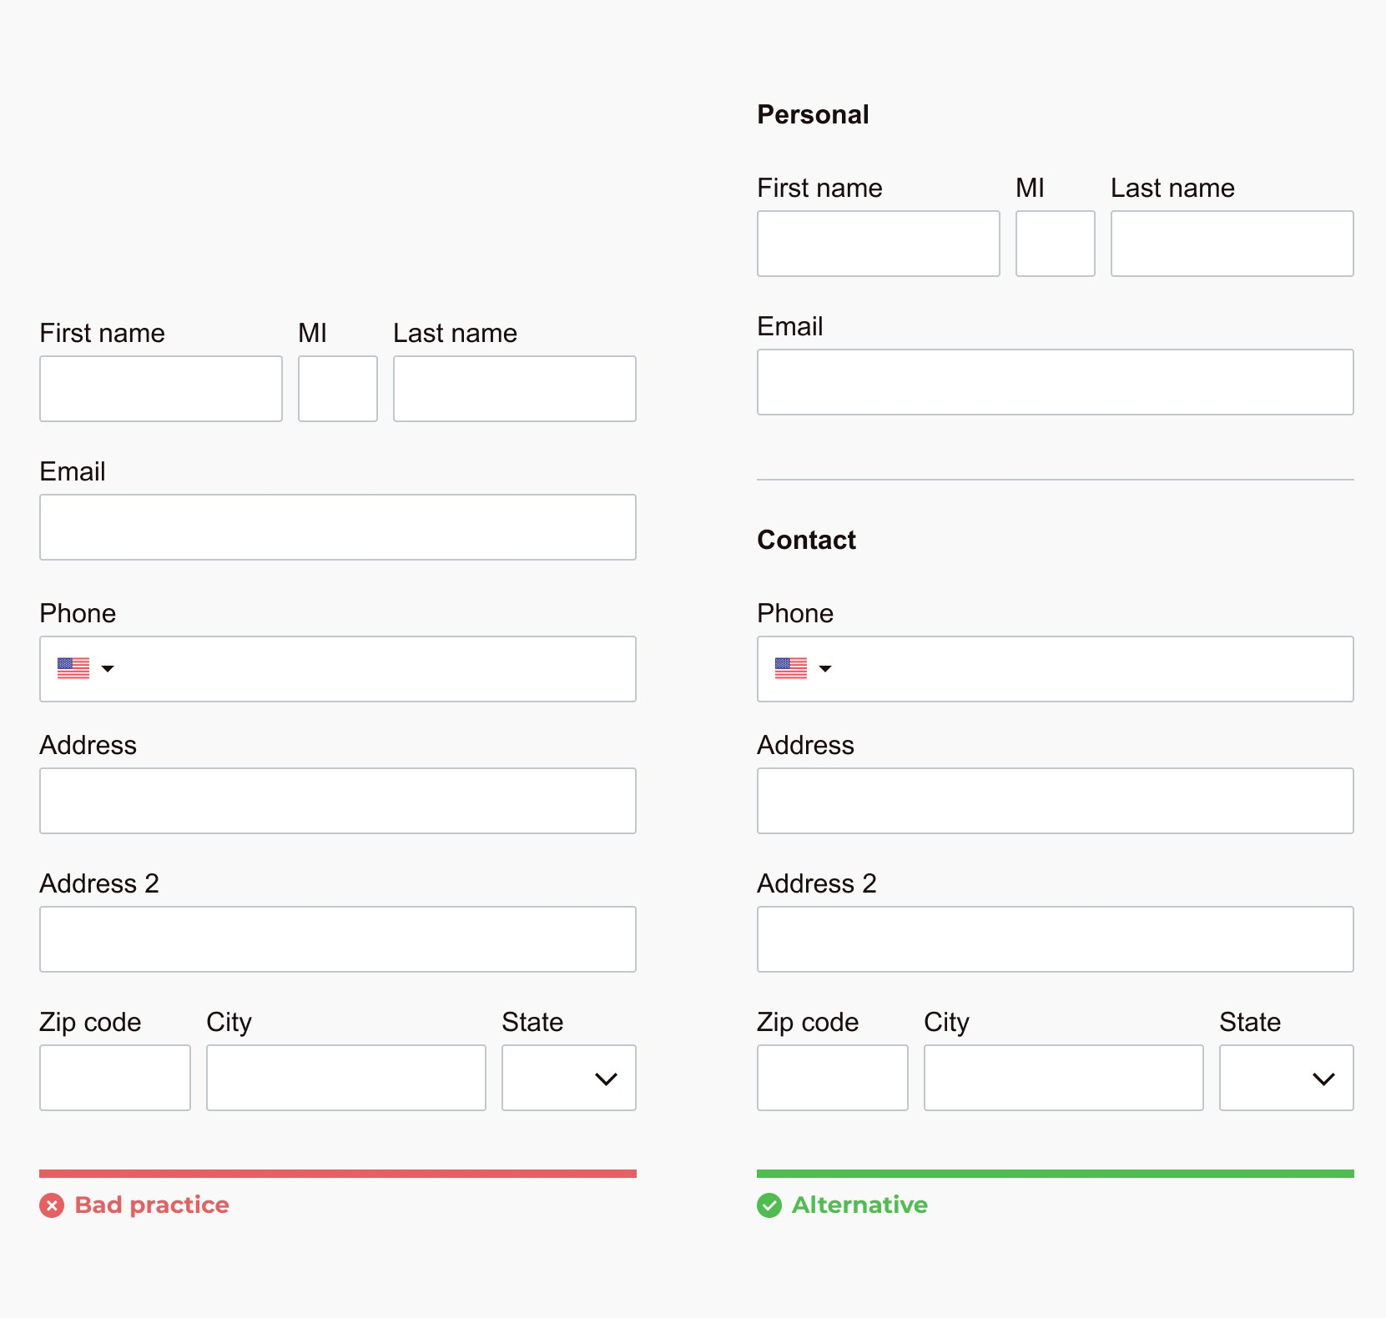
Group related fields
Filled out faster and reduces cognitive overload

Slide 26
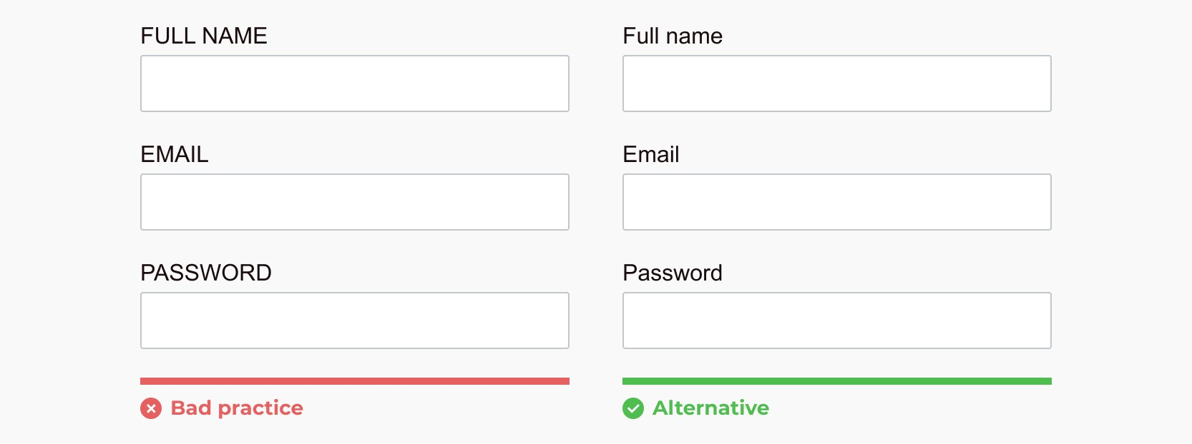
AVOID ALL CAPS
All caps make things hard and tiring to read

Slide 27
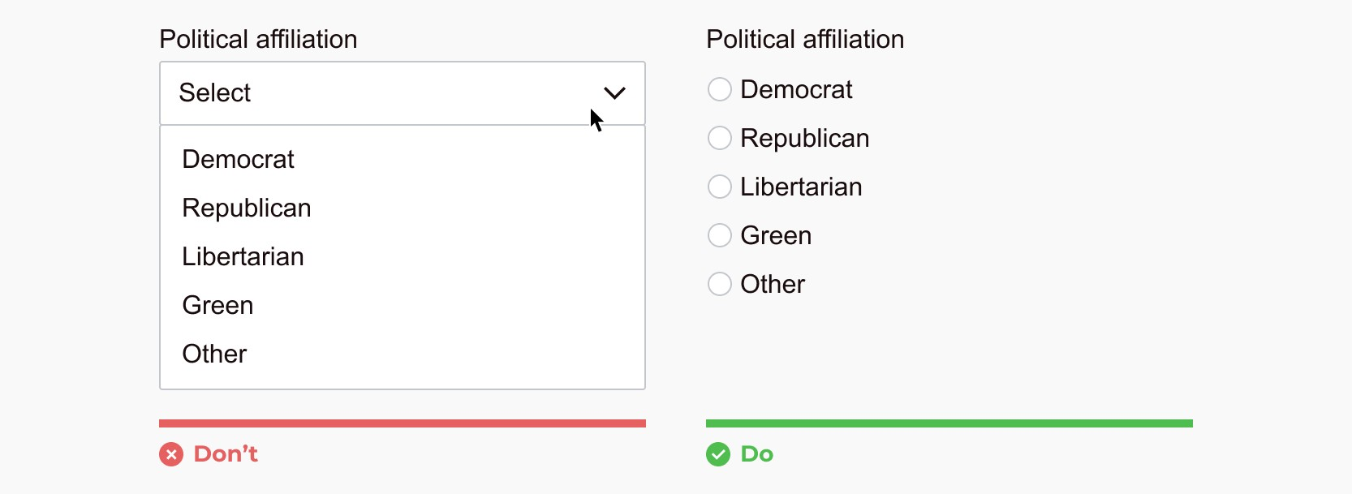
For online forms: Show all options if < 6 (unless space is limited)
Dropdown selector requires 2 clicks

Slide 28
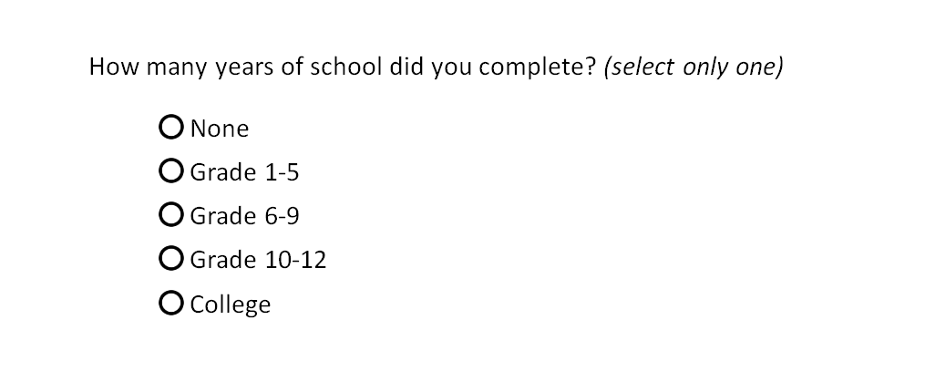
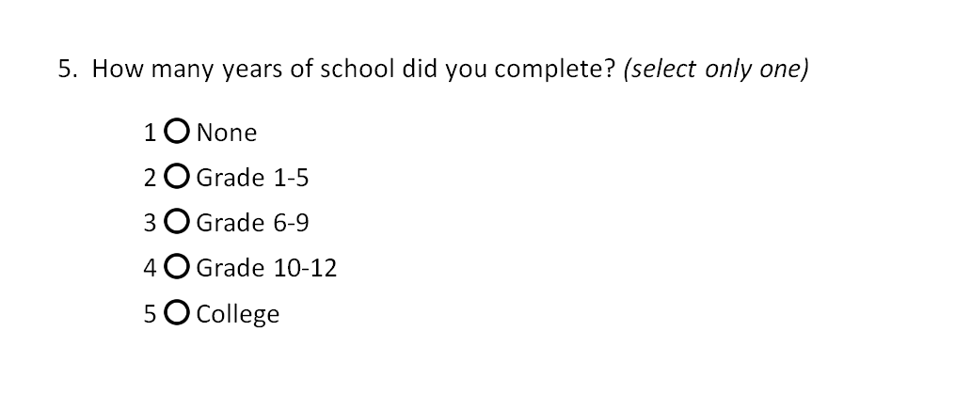
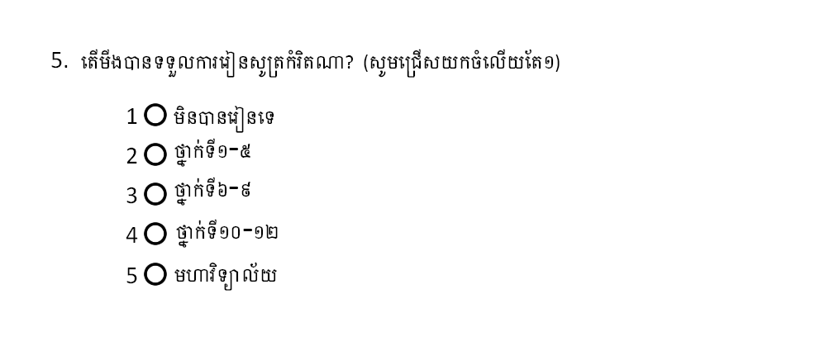
Number questions and responses

Slide 29
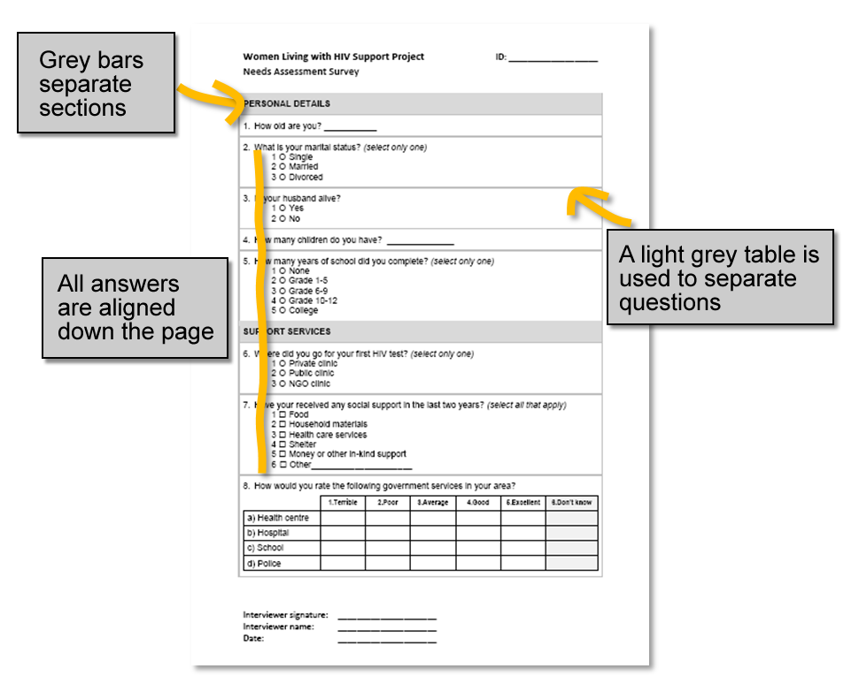
Use Formatting to guide the data collectors
Give each sheet a unique ID number
Avoid 2x-sided sheets
Add Collector info

Slide 30
Reduce Cognitive Overload (aka keep it simple)
Write as little as possible

Slide 31
Assignment
Redo your paper data form
Create a Google Form to enter the data
Send me:
the original form
the revised one
A link to the google form
If you don’t have one, you can do the assignment with the Line Transect Sheet”

Slide 33
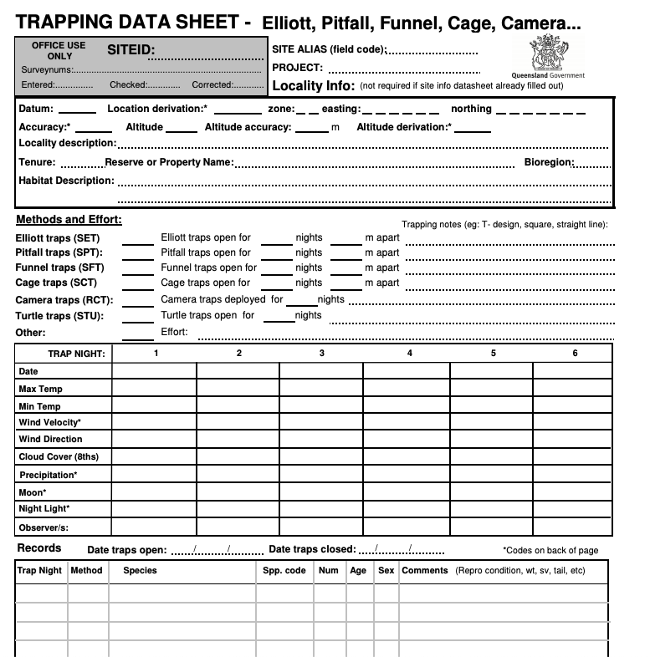
https://www.qld.gov.au/__data/assets/pdf_file/0030/68259/fauna-survey-datasheets.pdf

Slide 34
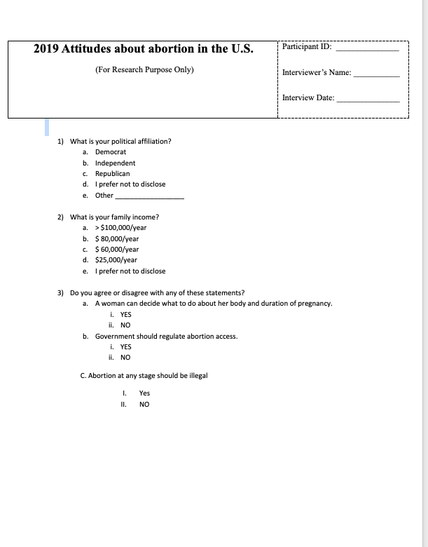
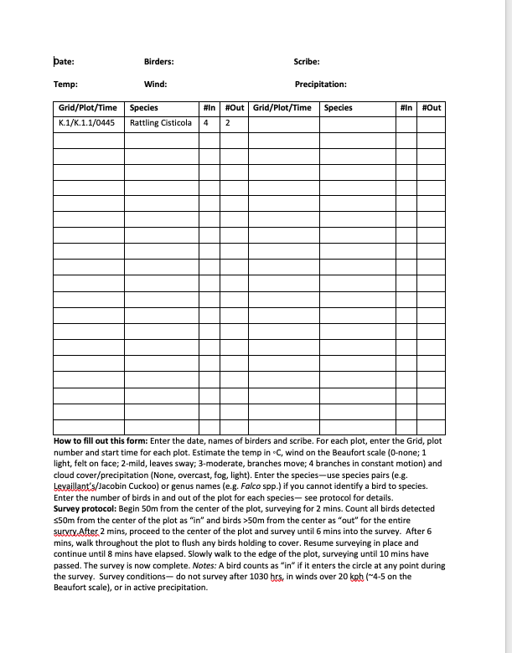

Slide 35
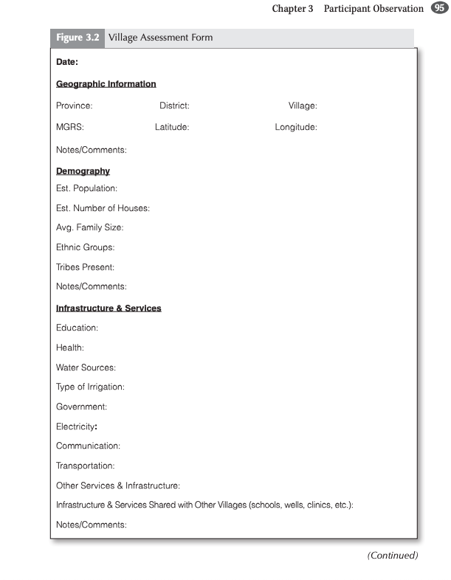
https://www.sagepub.com/sites/default/files/upm-binaries/48454_ch_3.pdf

Slide 36
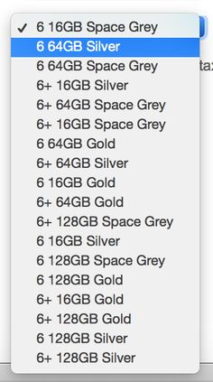
Format Data Sheets (paper or digital) to simplify data collection, minimize errors, and simplify data entry
Options
Constraints
Validation
Formatting
Codes / Minimize Writing
Large Text, White Space
Few Columns
Bold, Boxes, & other visual Cues
Pre-test

